Slide 1

Learning Management App
By
Satya

Slide 2
Requirements
Track courses information​
Course approval by the manager​
Once the Course application status changes to selected/rejected, automatically send selection/rejection letter to the Aspirant​
When the course is started, and that course type is paid then send the notification to the user regarding payment due.​
The manager should be able to see the details of the aspirant information​
Aspirants should not edit the course content​
The Aspirant should get the notification of what task is assigned to him by the manager​
The manager should get the notification when the task is completed by the Aspirant​
Create an open discussion public chatter which is used to share the information regarding the doubt in any topic​
Should track the course status of aspirant via reports​
Once the course is completed, Aspirant should get the email that he has successfully completed the course​

Slide 3
Topics Covered
Data Modeling - Objects, Fields and Relationships (Lookup)​
Process Automation – Approval Process, Process Builder, Email Alerts
User Interface - Page Layouts, Search Layouts, Actions​, List Views
Security - OWD, Profiles
​Reports, Activity Management and collaboration, Tasks and custom notification
Requirements | Topics Included
Track courses information​ | List views
Course approval by the manager​ | Approval Process, Email templates
Course application status selection/rejection | Process Builder, Email template, Email alert
Payment due notification when type of course is paid | Process Builder, Email template, Email alert
Manager should be able to see the details of the aspirant information | Profile permissions(Manager)
Aspirants should not edit the course content​ | Profile permissions(Aspirant profile)
Aspirant should get the notification of what task is assigned to him by the manager | Tasks, Custom Notification, Process Builder
Manager should get the notification when the task is completed by the Aspirant | Tasks, Custom Notification, Process Builder
Open discussion public chatter which is used to share the information regarding the doubt in any topic​ | Chatter
Should track course status of aspirant via reports​ | Reports
The course is completed, Aspirant should get the email that he has successfully completed the course​ | Process Builder, Email Alert

Slide 4
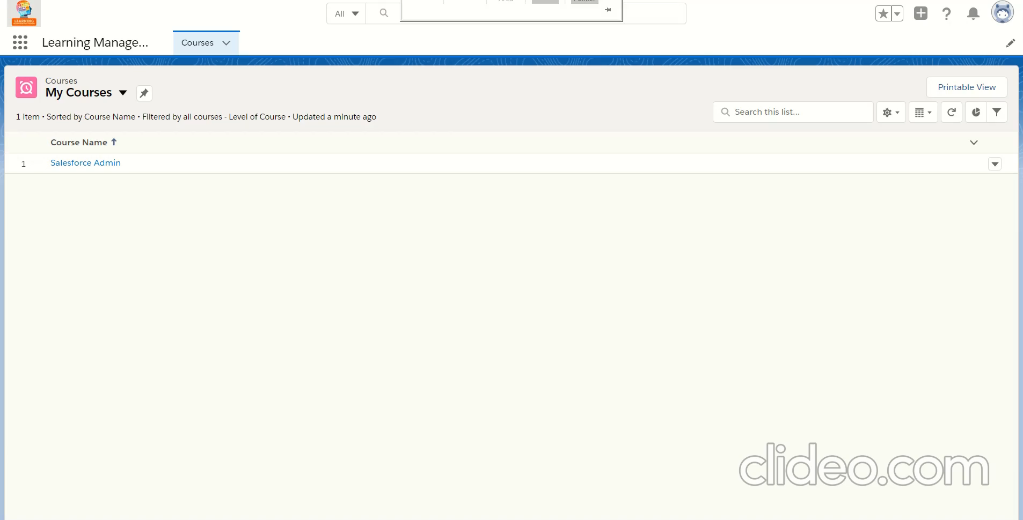
Track course information
This requirement tracks the course information from the user end by creating a custom list view in which he will see the related courses and he can pin that list to view the custom list every time.
User Account

Slide 5

Course approval by the manager
User when open the courses then he will submit the course for approval then manager will get the notification and he will approve/reject based on his need
User Account
Manager Account

Slide 6
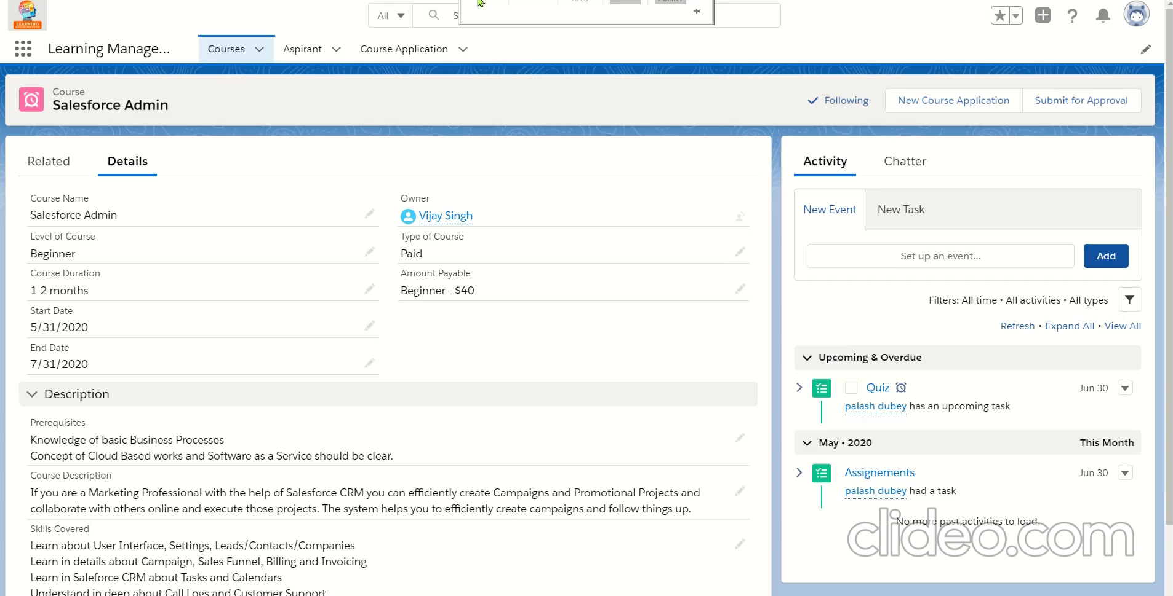
Course approval by the manager
Course application status changes to selected/rejected, automatically send selection/rejection letter to the Aspirant
Manager Account

Slide 7
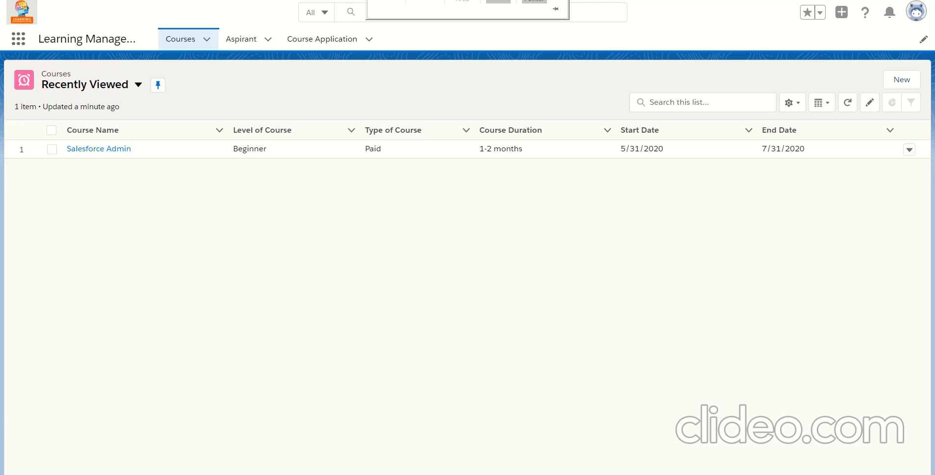
When the course is started, and that course type is paid then send the notification to the user regarding payment due.​
Manager Account

Slide 8
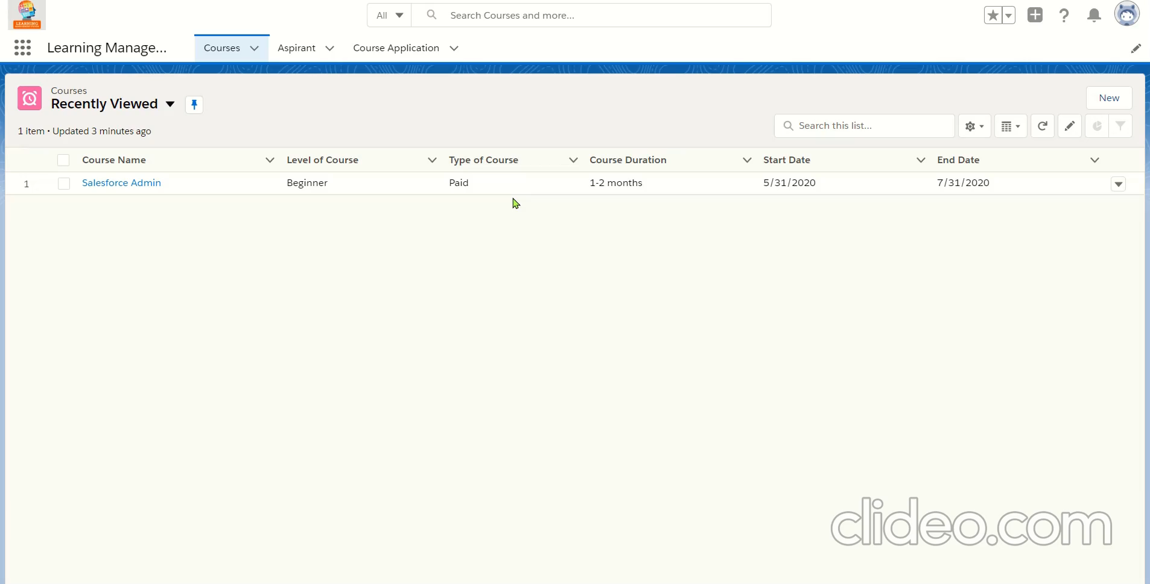
The manager should be able to see the details of the aspirant information​
Manager Account

Slide 9
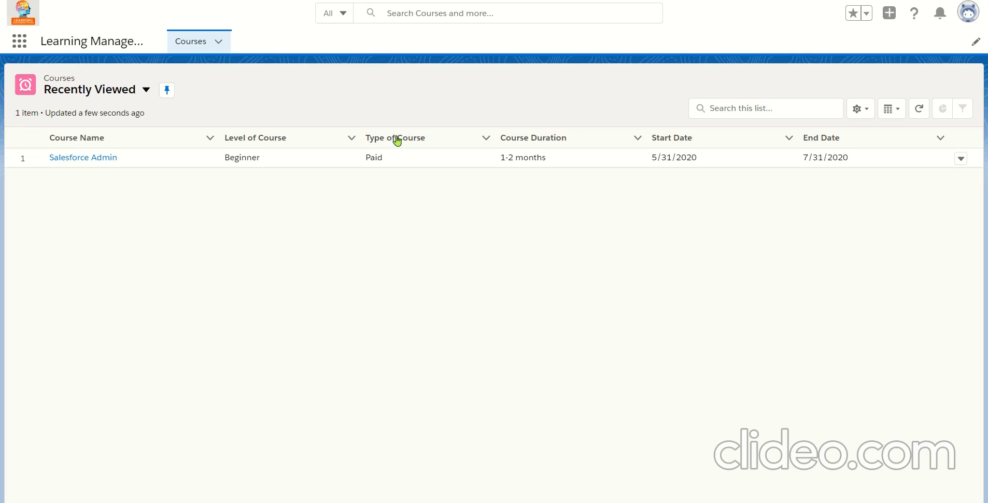
Aspirants should not edit the course content​
User Account

Slide 10
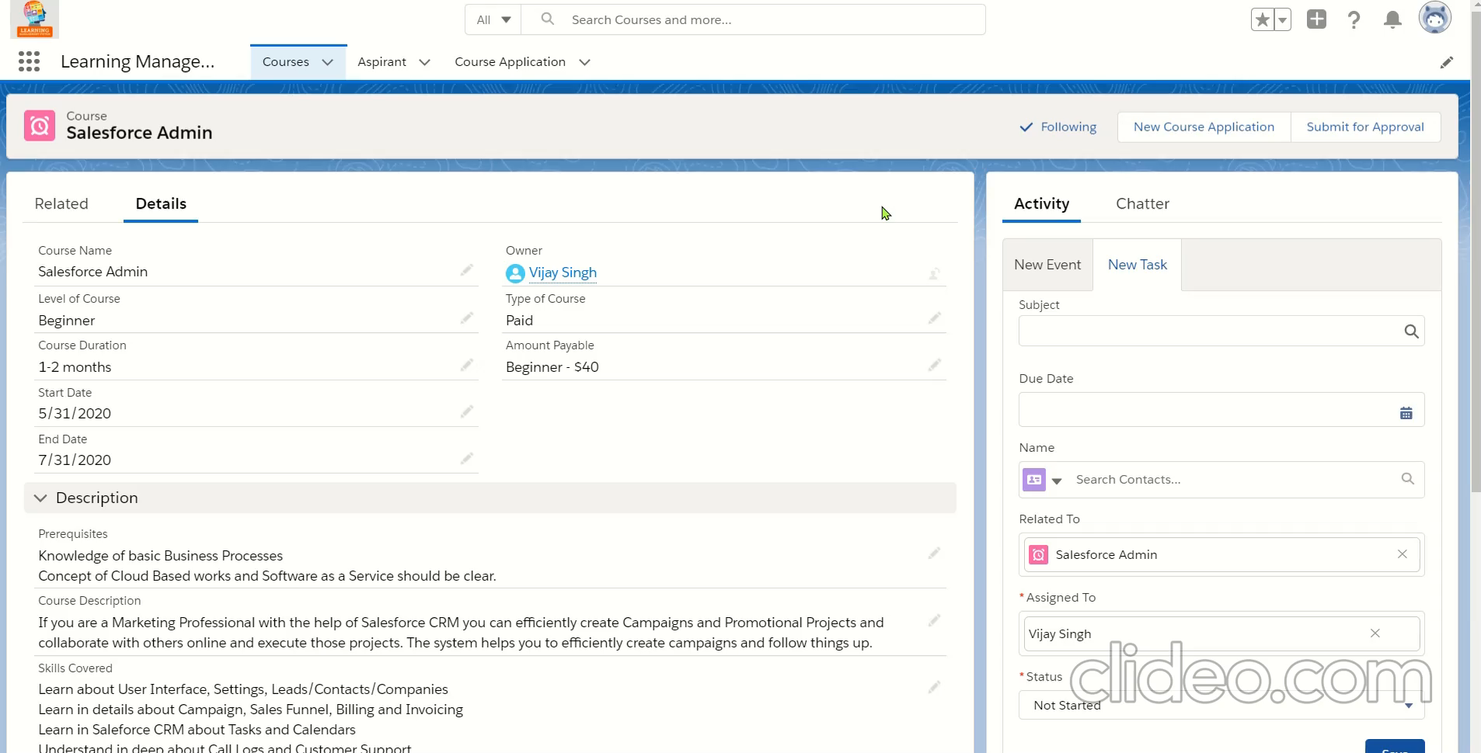
The Aspirant should get the notification of what task is assigned to him by the manager​
Manager Account
User Account

Slide 11
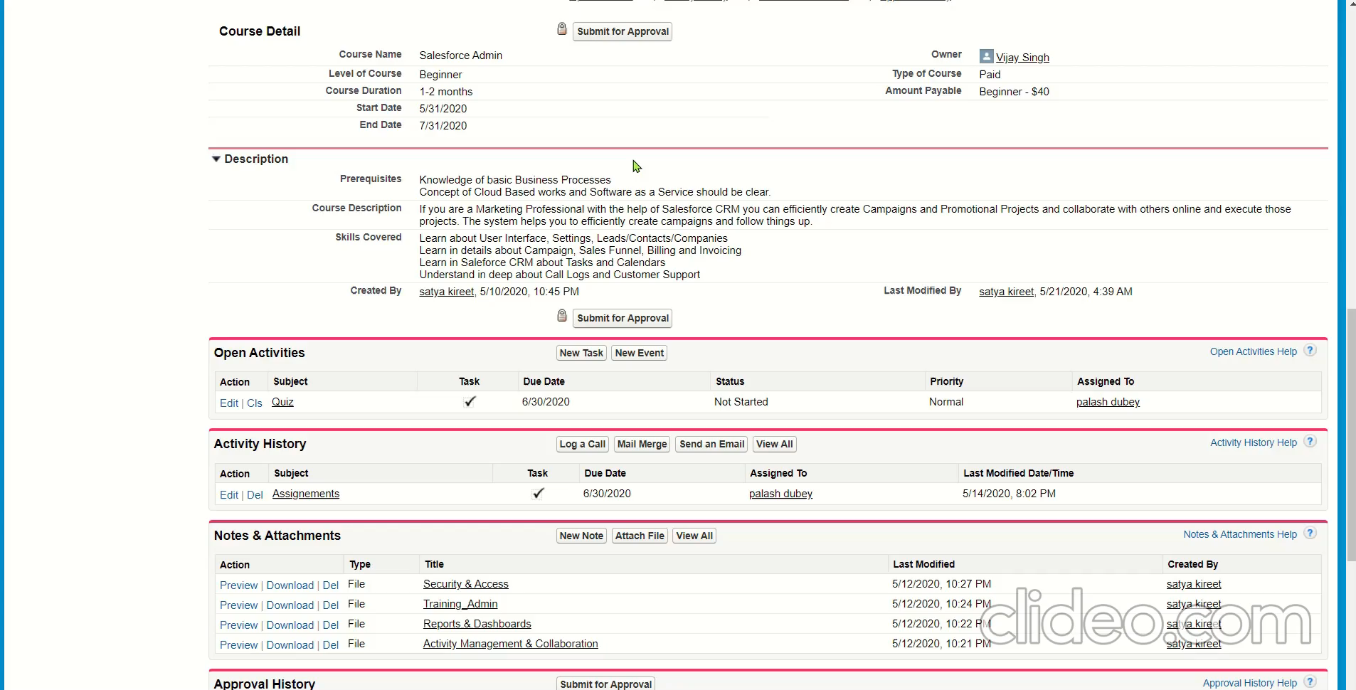
The manager should get the notification when the task is completed by the Aspirant​
Represented in salesforce classic as there are some issues in attaching file in notes and attachment through salesforce lightening
User Account
Manager Account

Slide 12
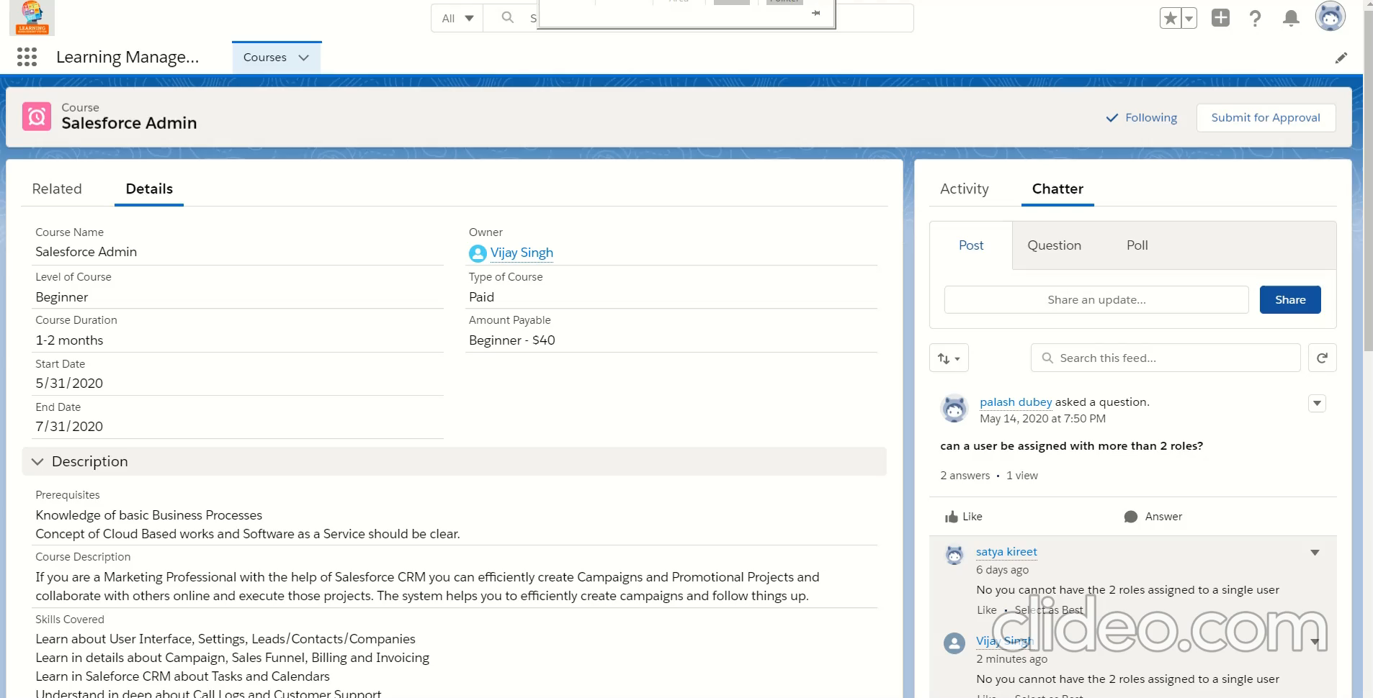
Create an open discussion public chatter which is used to share the information regarding the doubt in any topic​
User Account

Slide 13
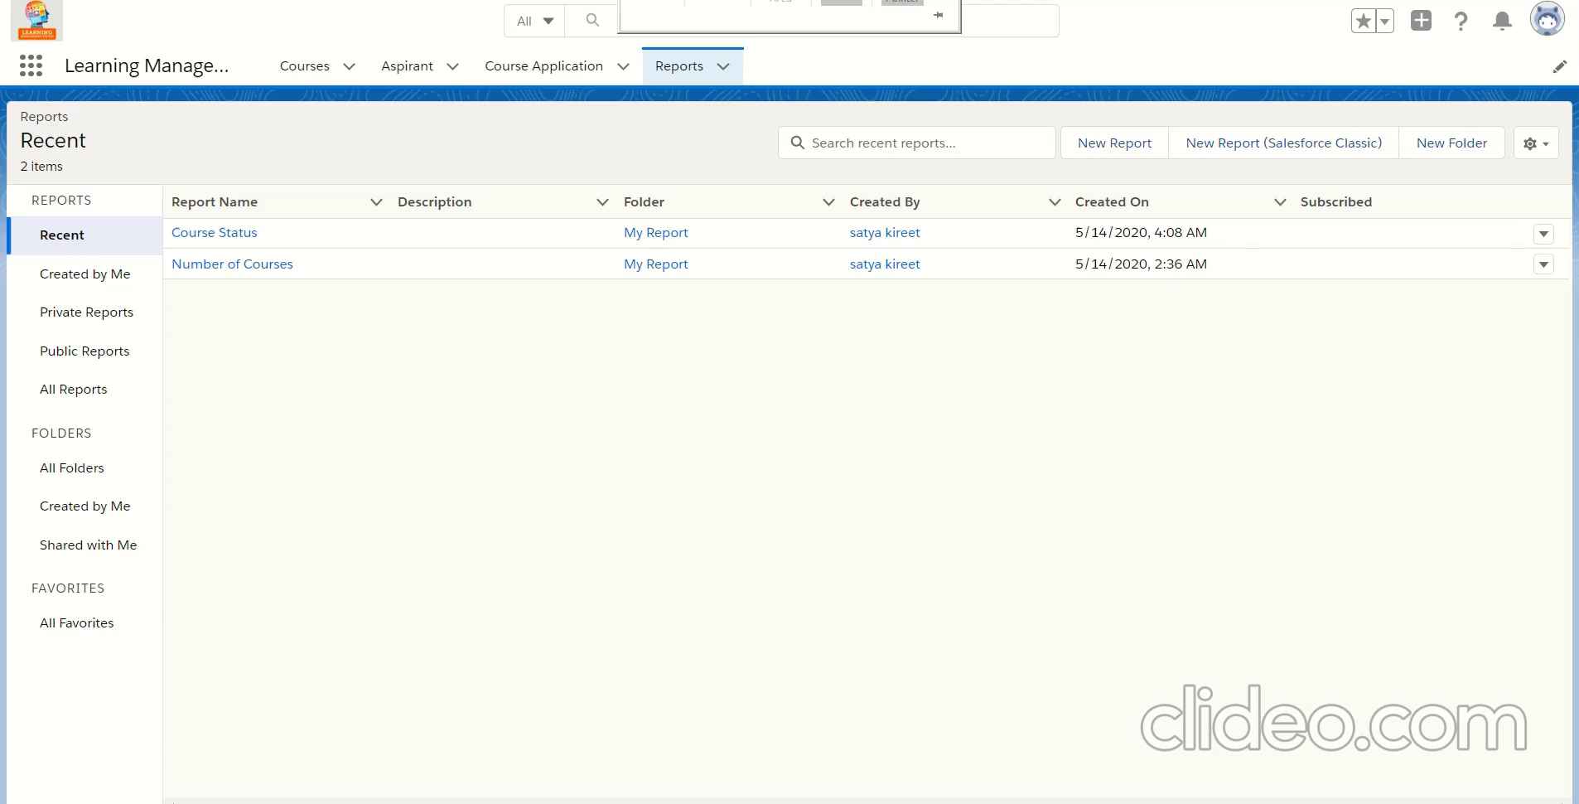
Should track the course status of aspirant via reports​
Manager Account

Slide 14
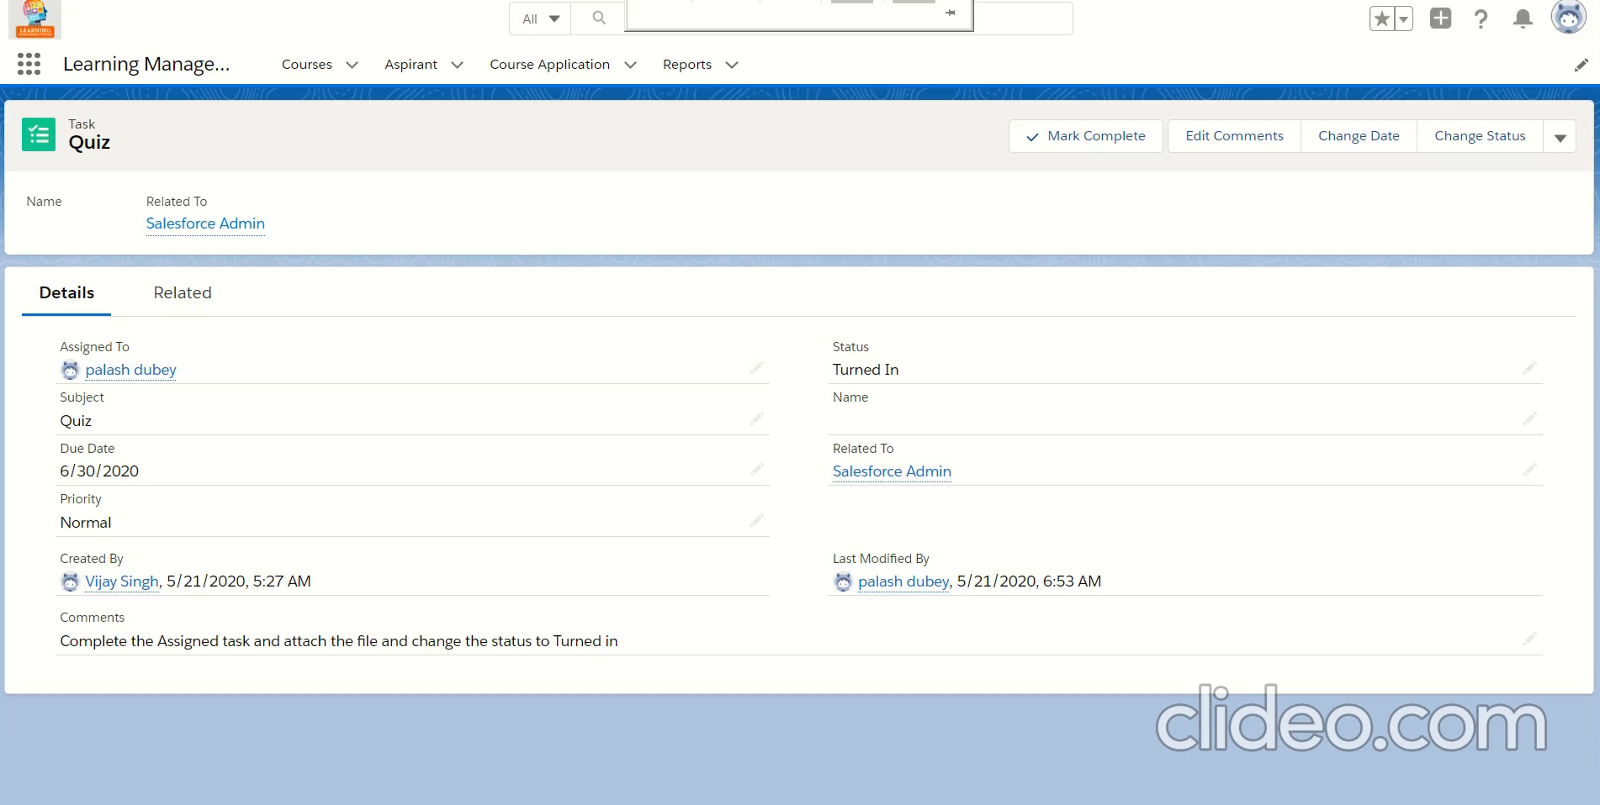
Once the task is completed, Aspirant should get the email that he has successfully completed the course​
Manager Account
User Account

Slide 15


